Slide 1
Multifaceted Collaborative Filtering Model
SMAI CSE 471
Spring 2019
Dr. Ravi Kiran
Team Name: Team Houdini
Mentor: Nikhil Gogate
Notes:
Be specific and direct in the title. Use the subtitle to give the specific context of the speech.
-The goal should be to capture the audience’s attention which can be done with a quote, a startling statistic, or fact. It is not necessary to include this attention getter on the slide.

Slide 2
Outline
Problem Statement
What are Recommender Systems ?
Motivation
Dataset
Models
Neighborhood Model
SVD++ Model
Integrated Model
Results
Challenges and Limitations
Notes:
Use the background points to post details that are not common knowledge, or that the audience will need to understand the context of the speech.
-Do not read these main points from the PowerPoint, instead elaborate on these points during the speech.

Slide 3
Problem Statement
To use collaborative filtering techniques to apply on Movie dataset that recommends the movies for users based on the reviews and past data.
Implement baseline CF models
Neighborhood model
SVD++ model
Improve them using technique that integrates the two models.
Notes:
Use the background points to post details that are not common knowledge, or that the audience will need to understand the context of the speech.
-Do not read these main points from the PowerPoint, instead elaborate on these points during the speech.

Slide 4
What are Recommender Systems ?
Information filtering system that seeks to predict the "rating" or "preference" a user would give to an item.
Two main types of Recommender Systems:
Content based
Collaborative Filtering
Neighborhood Model
SVD++(Latent Factor Model)
Used in variety of areas:
Video and music recommenders (Netflix, YouTube, Spotify)
Product recommenders (Amazon, Myntra)
Notes:
Use the background points to post details that are not common knowledge, or that the audience will need to understand the context of the speech.
-Do not read these main points from the PowerPoint, instead elaborate on these points during the speech.

Slide 5
Motivation
Enhancing user satisfaction and loyalty by matching consumers with appropriate products.
Netflix Prize - Open competition for best CF algorithm to predict user rating for films.
“We need to go win a million dollars”
Notes:
Use the background points to post details that are not common knowledge, or that the audience will need to understand the context of the speech.
-Do not read these main points from the PowerPoint, instead elaborate on these points during the speech.

Slide 6
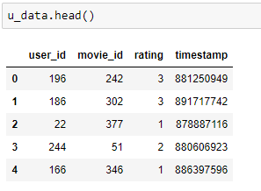
Dataset
MovieLens 100k data.
Collected by the GroupLens Research Project at the University of Minnesota.
100,000 ratings (1-5) from 943 users on 1682 movies.
Each user has rated at least 20 movies.
Fig1 : Dataset entries
Notes:
Use the background points to post details that are not common knowledge, or that the audience will need to understand the context of the speech.
-Do not read these main points from the PowerPoint, instead elaborate on these points during the speech.

Slide 7
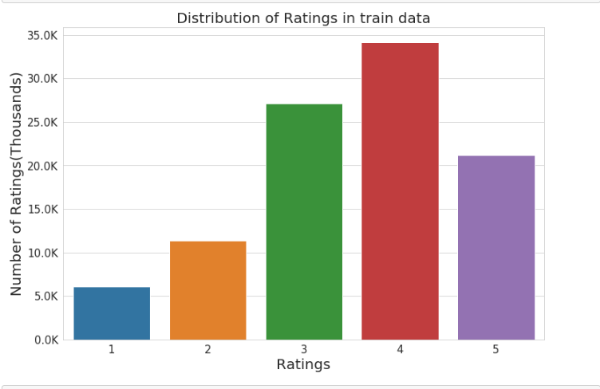
Dataset - EDA
Fig2 : Rating Distribution v/s Number of Ratings
Notes:
Use the background points to post details that are not common knowledge, or that the audience will need to understand the context of the speech.
-Do not read these main points from the PowerPoint, instead elaborate on these points during the speech.

Slide 8
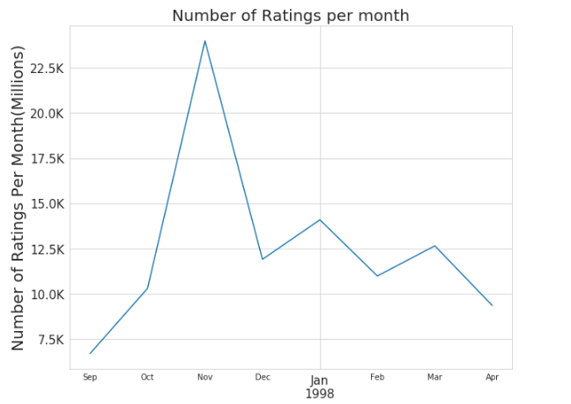
Dataset - EDA
Fig3 : Rating Distribution
Notes:
Use the background points to post details that are not common knowledge, or that the audience will need to understand the context of the speech.
-Do not read these main points from the PowerPoint, instead elaborate on these points during the speech.

Slide 9
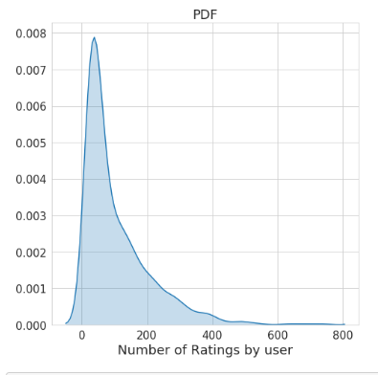
Dataset - EDA
Fig4 : PDF of Number of Ratings by user
PDF graph shows that almost all of the users give very few ratings. There are very few users who's ratings count is high.
Notes:
Use the background points to post details that are not common knowledge, or that the audience will need to understand the context of the speech.
-Do not read these main points from the PowerPoint, instead elaborate on these points during the speech.

Slide 10
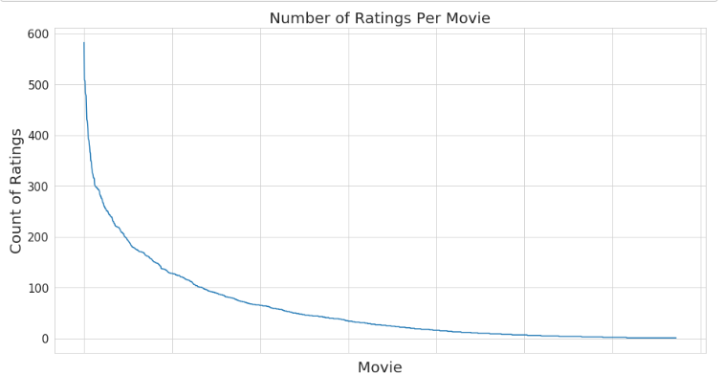
Dataset - EDA
Fig5 : Number of Ratings per Movie vs Count of Ratings
Some movies are very popular and rated by many users vs other movies.
Notes:
Use the background points to post details that are not common knowledge, or that the audience will need to understand the context of the speech.
-Do not read these main points from the PowerPoint, instead elaborate on these points during the speech.

Slide 11
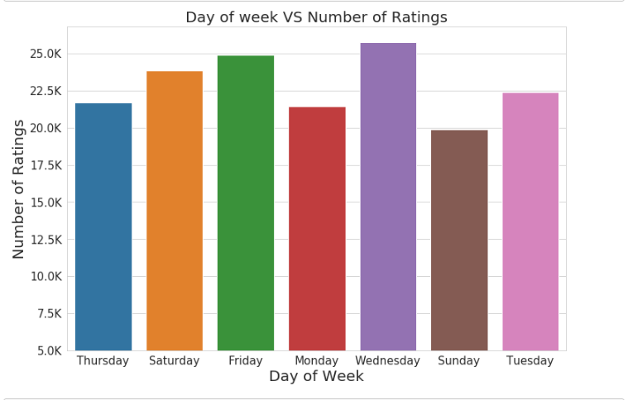
Dataset - EDA
Fig6 : Day of Week v/s Number of Ratings
Notes:
Use the background points to post details that are not common knowledge, or that the audience will need to understand the context of the speech.
-Do not read these main points from the PowerPoint, instead elaborate on these points during the speech.

Slide 12

Baseline estimate
Baseline estimate for predicting rating for movie i by user u (b_{ui})
User bias (b_{u})
Item bias (b_{i})
Rating by user u for item i (r_{ui}).
Implicit feedback (N(u)) contains all items for which implicit preference was provided by user u.)
Notes:
Use the background points to post details that are not common knowledge, or that the audience will need to understand the context of the speech.
-Do not read these main points from the PowerPoint, instead elaborate on these points during the speech.

Slide 13

Neighborhood model
User oriented CF system.
Estimate unknown ratings based on recorded ratings of like minded users.
A rating is estimated using known ratings made by the same user on similar items.
Similarity measure between items (cosine, Pearson’s correlation).
The predicted value of r_{ui} is taken as a weighted average of the ratings of neighboring items, while adjusting for user and item effects through the baseline estimates.
s_{ij} – similarity between items i and j.
Notes:
Use the background points to post details that are not common knowledge, or that the audience will need to understand the context of the speech.
-Do not read these main points from the PowerPoint, instead elaborate on these points during the speech.

Slide 14

SVD and SVD++ model
Matrix factorization is a class of collaborative filtering algorithms.
A popular approach to latent factor models is induced by an SVD-like lower rank decomposition of the ratings matrix.
Each user u is associated with a user-factors vector p_{u} ∈ R_{f} , and each item i with an item-factors vector q_{i} ∈ R_{f} .
Prediction is done by the rule:
This is the SVD model. An improvement to this model is Asymmetric SVD which uses implicit feedback.
As we do not really have much independent implicit feedback for the our ml-100k dataset, so we turn towards an improved model.
Notes:
Use the background points to post details that are not common knowledge, or that the audience will need to understand the context of the speech.
-Do not read these main points from the PowerPoint, instead elaborate on these points during the speech.

Slide 15

SVD and SVD++ model
Its results are more accurate than all previously published methods on the Netflix data and other similar movie datasets which struggles with the same implicit feedback limitation.
SVD++ model :
Notes:
Use the background points to post details that are not common knowledge, or that the audience will need to understand the context of the speech.
-Do not read these main points from the PowerPoint, instead elaborate on these points during the speech.

Slide 16
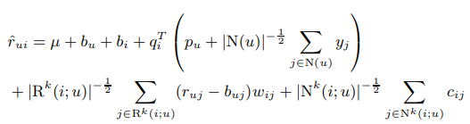
Integrated model
A combined model which will sum the predictions of previously defined neighborhood and SVD++ model.
Notes:
Use the background points to post details that are not common knowledge, or that the audience will need to understand the context of the speech.
-Do not read these main points from the PowerPoint, instead elaborate on these points during the speech.

Slide 17
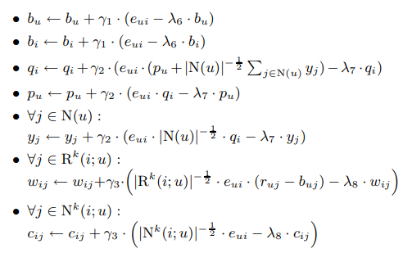
Integrated model
Backprop for Integrated model :
Notes:
Use the background points to post details that are not common knowledge, or that the audience will need to understand the context of the speech.
-Do not read these main points from the PowerPoint, instead elaborate on these points during the speech.

Slide 18
Integrated model
Parameters used :
Meta parameters: γ1 = γ2 = 0.007, γ3 = 0.001, λ6 = 0.005, λ7 = λ8 = 0.015.
We decrease step sizes (the γ’s) by a factor of 0.9 after each iteration.
All results are measured for Epochs of 30.
Epoch time for running the models on Kaggle were :
Neighborhood Model : 1.312 mins
SVD++ model : 2.45 mins
Integrated model : 4.54 mins
Notes:
Use the background points to post details that are not common knowledge, or that the audience will need to understand the context of the speech.
-Do not read these main points from the PowerPoint, instead elaborate on these points during the speech.

Slide 19
Results
Neighborhood Model | SVD++ | Integrated Model
1.7757 | 0.941 | 0.9283
Error in RMSE (root mean square error)
Notes:
Use the background points to post details that are not common knowledge, or that the audience will need to understand the context of the speech.
-Do not read these main points from the PowerPoint, instead elaborate on these points during the speech.

Slide 20
Limitations
Insufficient hardware support to run large dataset (Netflix dataset), even in CSR format.
Better sources needed for implicit feedback.
Data sparsity
Scalability
Cold Start Problem.
Notes:
Use the background points to post details that are not common knowledge, or that the audience will need to understand the context of the speech.
-Do not read these main points from the PowerPoint, instead elaborate on these points during the speech.

Slide 21
Thank you.
Thank You.
Notes:
The action step is what the audience is supposed to do or think about the topic. It should be one sentence that is written clearly and with much thought. It may also be the thesis statement restated as an action. The goal of this slide is to leave the audience with a clear message as to what they are to do or think at the end of the speech. It may be a good idea to end with a powerful quote or image.

